Slide 1
Software Engineering
Prepared by: Neha Tripathi

Slide 2
Program Vs Software

Slide 3
What Is A Computer Program
Program is a set of instructions written in a programming language used to execute for a specific task or particular function.
A program does not have further categorization.
A program cannot be software.
A program consists of a set of instructions which are coded in a programming language like c, C++, PHP, Java etc.
Programs do not have a user interface.
A program is developed and used by either a single programmer or a group of programmers.
A program is compiled every time when we need to generate some output from it.
Program has limited functionality and less features.
Program functionality is dependent on compiler.
A program takes less time to build/make.
Program development approach is un-procedural, un-organized and unplanned.
The size of a program ranges from kilobytes (Kb) to megabytes (Mb).
Examples of computer programs include: Operating system, office suite, video games, malware, a web browser like Mozilla Firefox and Apple Safari.

Slide 4
What Is A Computer Software
Software is a collection of several programs and other procedures and documentation.
Software can be categorized into two categories: application software and system software.
Software can be a program.
Software consists of bundles of programs and data files. Programs in specific software use these data files to perform a dedicated type of tasks.
Every software has a dedicated user interface. The user interface of software may be in the form of a command prompt or in a graphical format.
Software is developed by either a single programmer or a group of programmers.
Whole software is compiled, tested and debugged during the development process.
Software has lots of functionality and features such as GUI, input/output data, process etc.
Software functionality is dependent on the operating system.
Software takes relatively more time to build/make when compared to program.
Software development approach is systematic, organized and very well planned.
The size of a software ranges from megabytes (Mb) to Gigabytes (Gb).
Examples of software include: Microsoft Word, Microsoft Excel, VLC media player, Firefox, Adobe Reader, Windows, Linux, Unix, Mac etc.

Slide 5
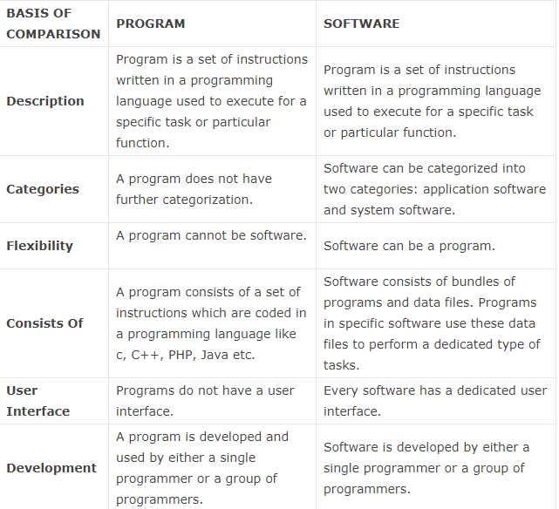
Program Vs Software

Slide 6
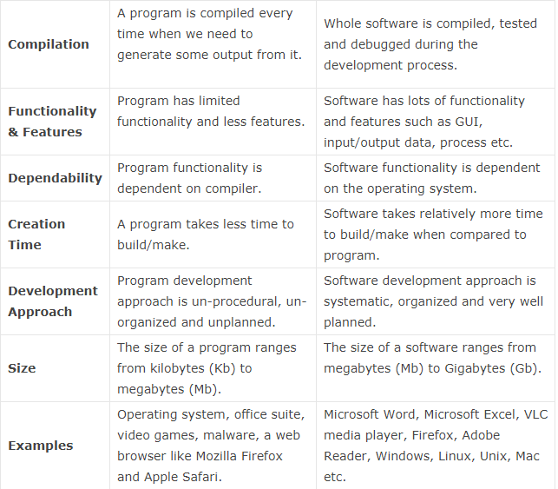
Program Vs Software(continue…)

Slide 7
Program Vs Software(continue…)
Usually small in size
Author himself is sole user
Single developer
Lacks proper user interface
Lacks proper documentation
Ad hoc development.
Large
Large number of users
Team of developers
Well-designed interface
Well documented & user-manual prepared
Systematic development

Slide 8
Thank You!

